Slide 1



Workshop on First Principles Density Functional Theorem (FP-DFT) for Materials Simulation in Quantum Espresso
Part-1: Fundamental theorem and principles
IEEE KUET SB, March 17, 2023
Disclaimer: Presentation slides are accumulated for non-profit academic/research purpose only.
Acknowledgement: All the slides are collected from online resources (see references). All credits to the three slides attached in the end section.
Presented By: Md. Rayid Hasan Mojumder, Jikrul Sayeed, and Md. Sakib Hassan

Slide 2
Outline
Ab initio materials modelling
Quantum Mechanics
First-principles calculations: approximations
Born-Oppenheimer approximation
Density Functional Theorem
Bloch’s theorem – periodic system
Electron-ion interaction (pseudopotential)
DFT : Practical considerations
References

Slide 3
Ab initio materials modelling

Slide 4
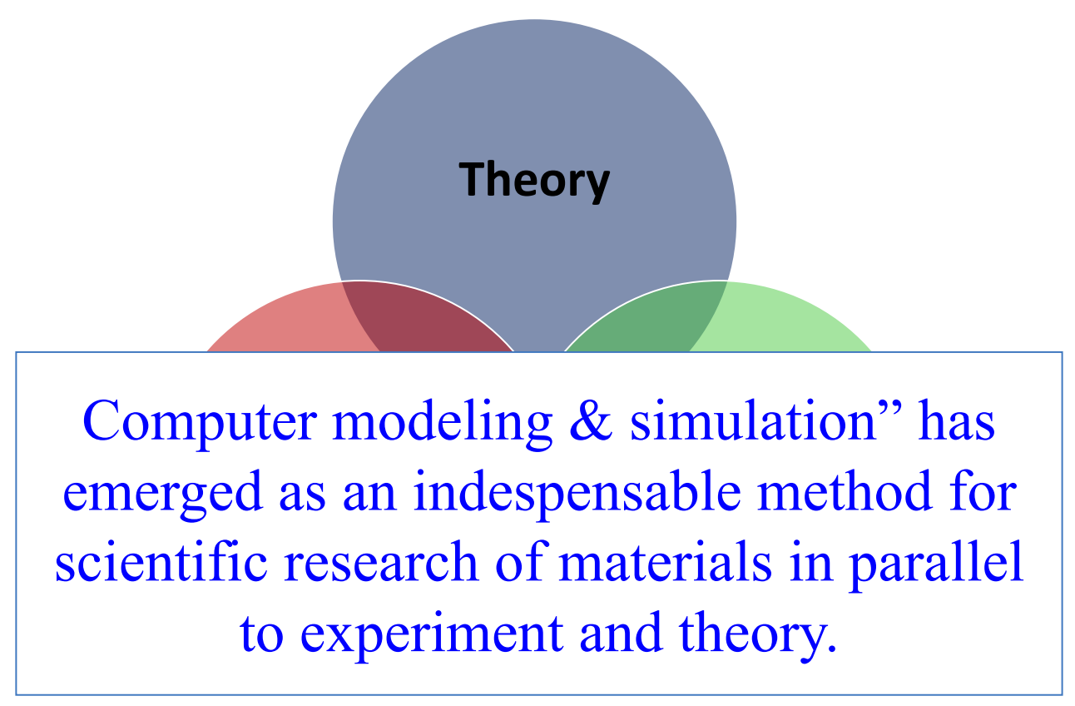
Computer Modeling & Simulation

Slide 5
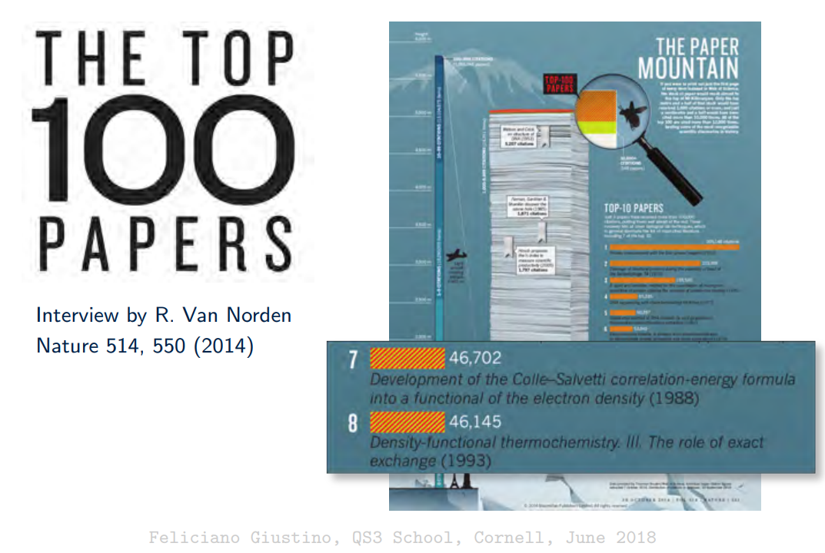
Impact of DFT

Slide 6
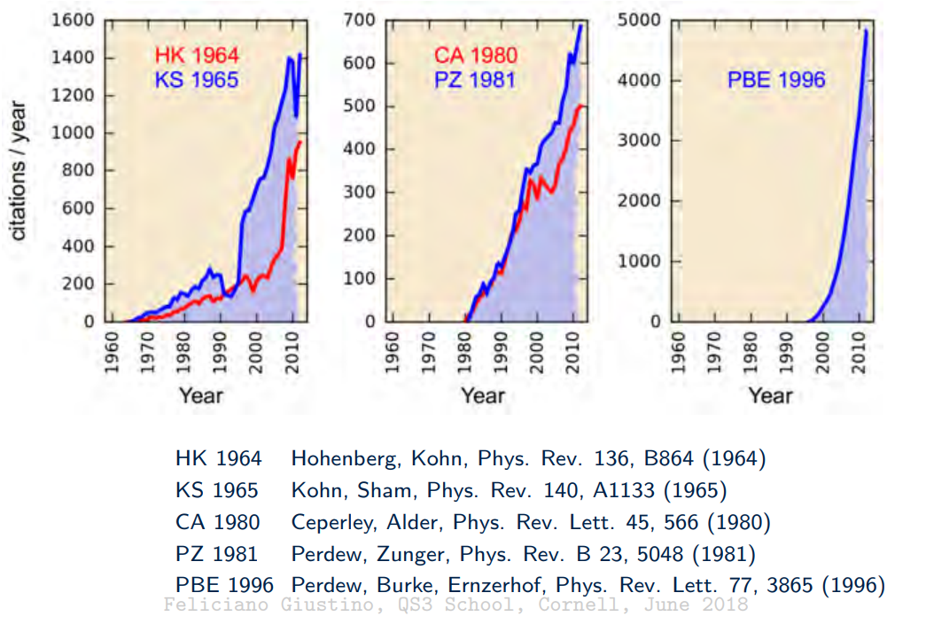
Impact of DFT

Slide 7
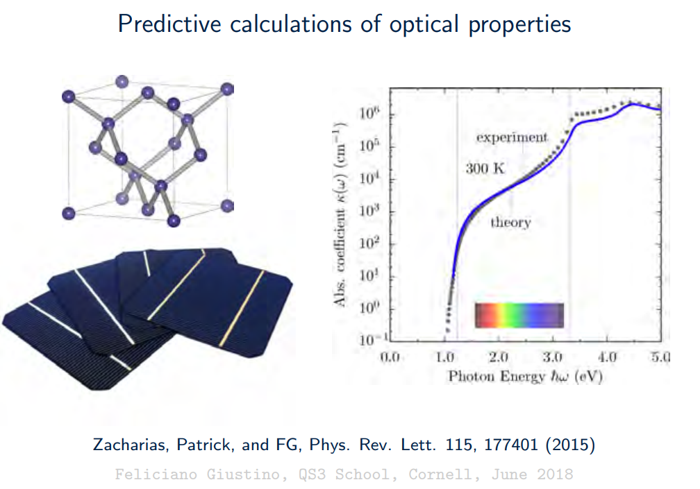
Examples of calculations based on DFT

Slide 8
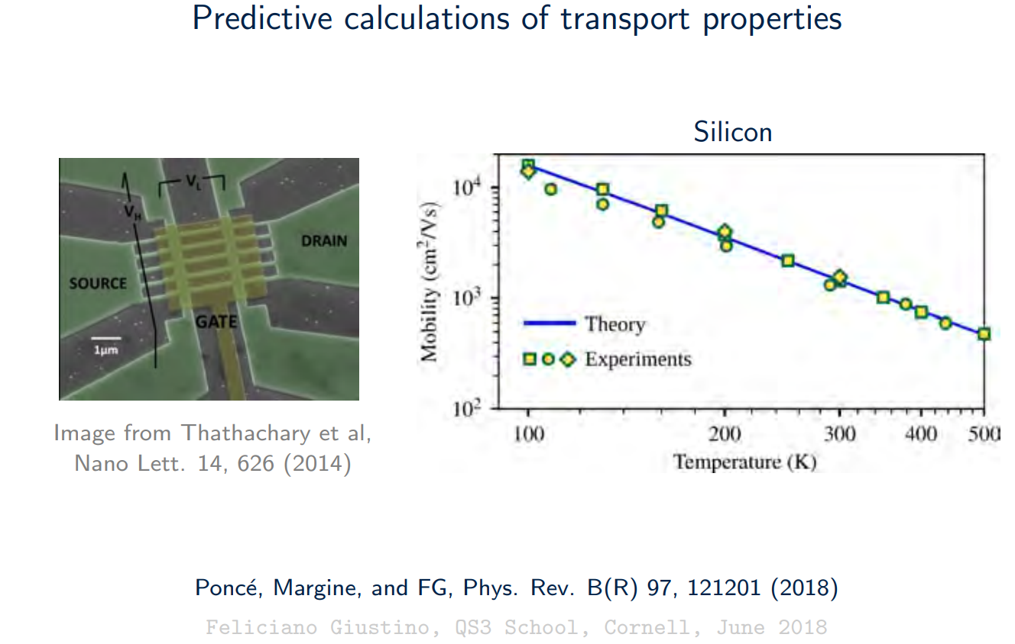
Examples of calculations based on DFT

Slide 9
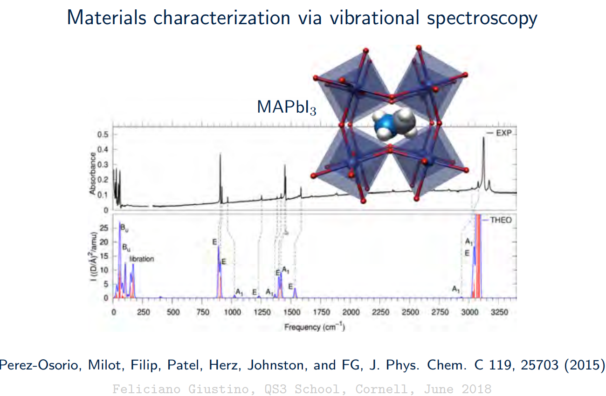
Examples of calculations based on DFT

Slide 10
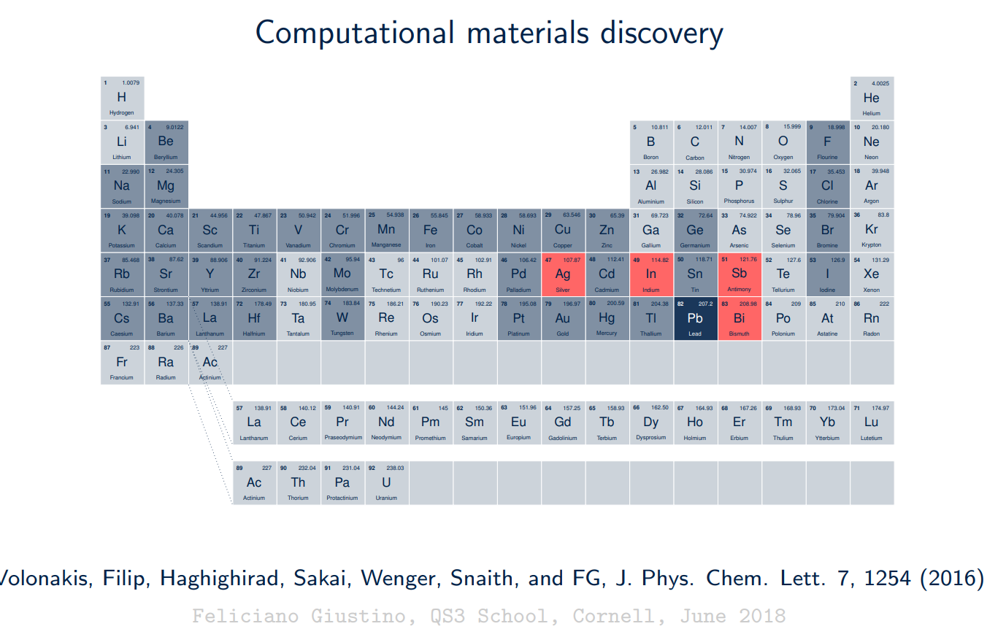
Examples of calculations based on DFT

Slide 11
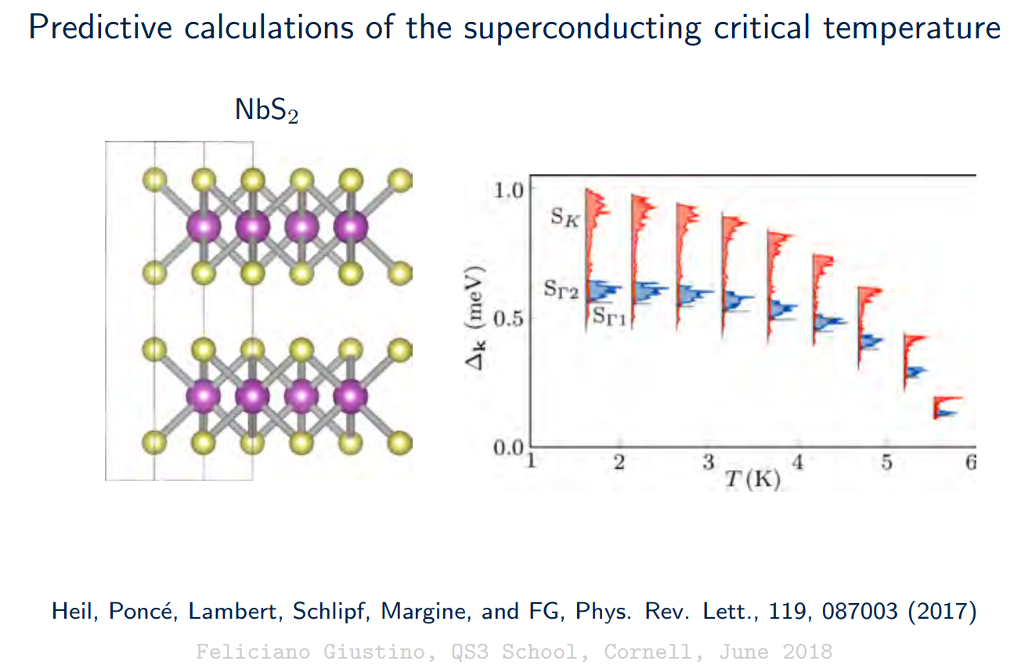
Examples of calculations based on DFT

Slide 12
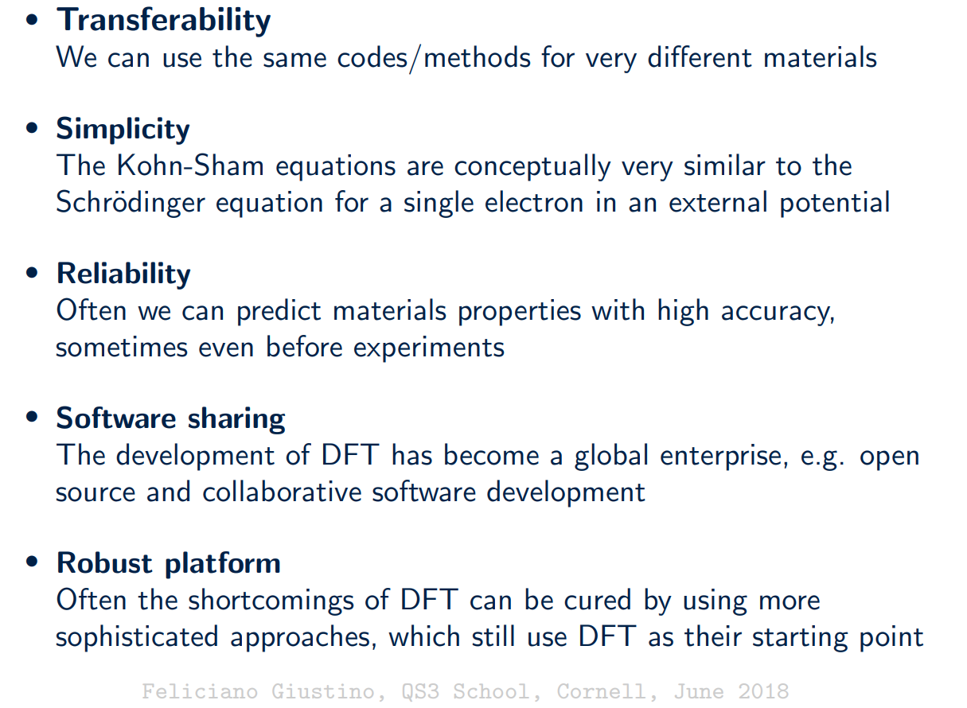
Why is DFT so popular?

Slide 13
Quantum Mechanics

Slide 14
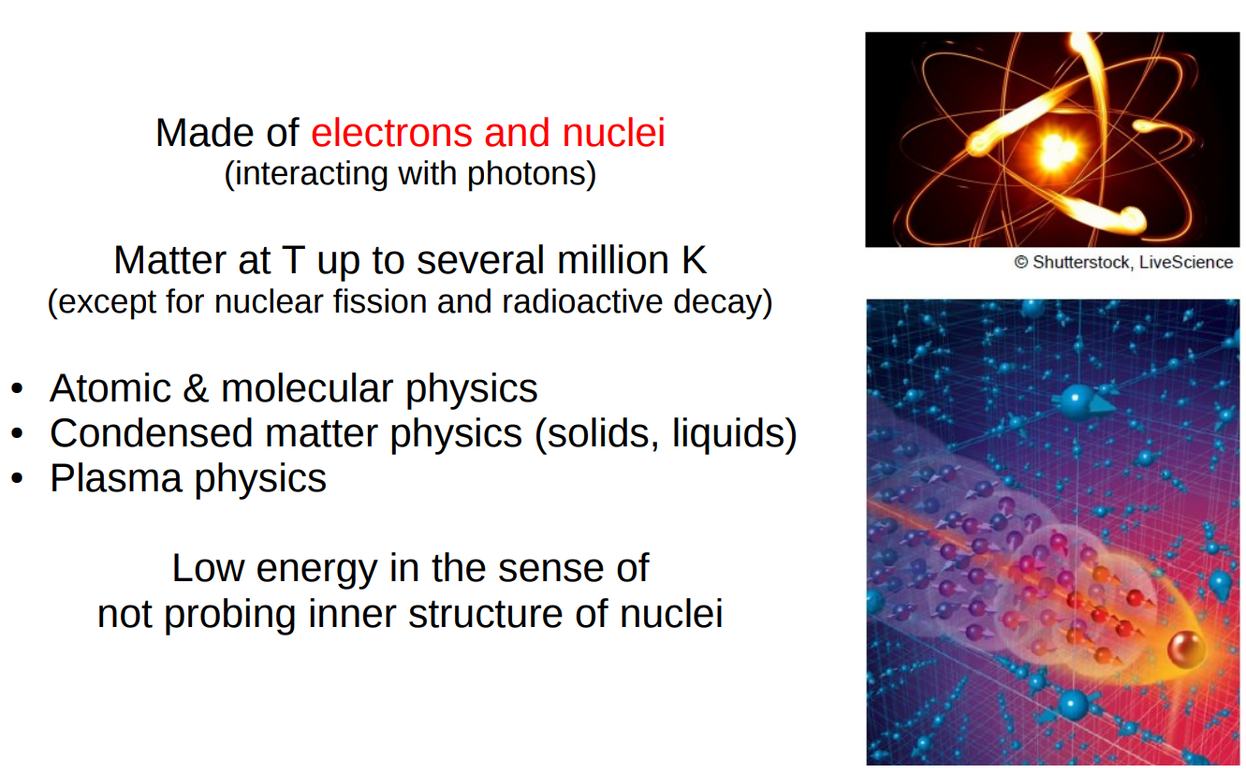
The physics of low-energy matter

Slide 15
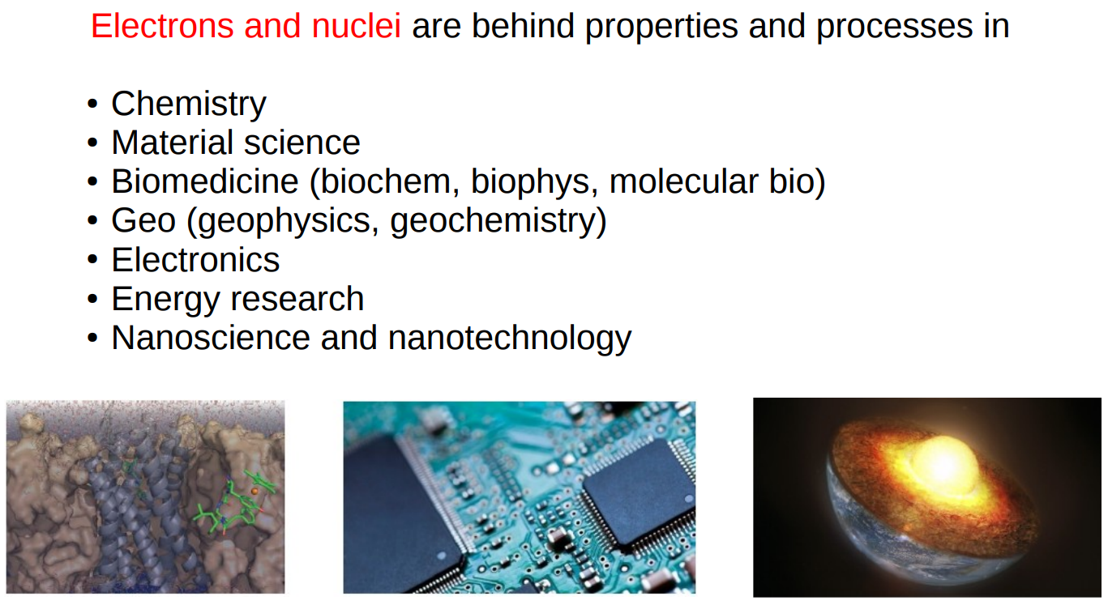
The physics of low-energy matter

Slide 16
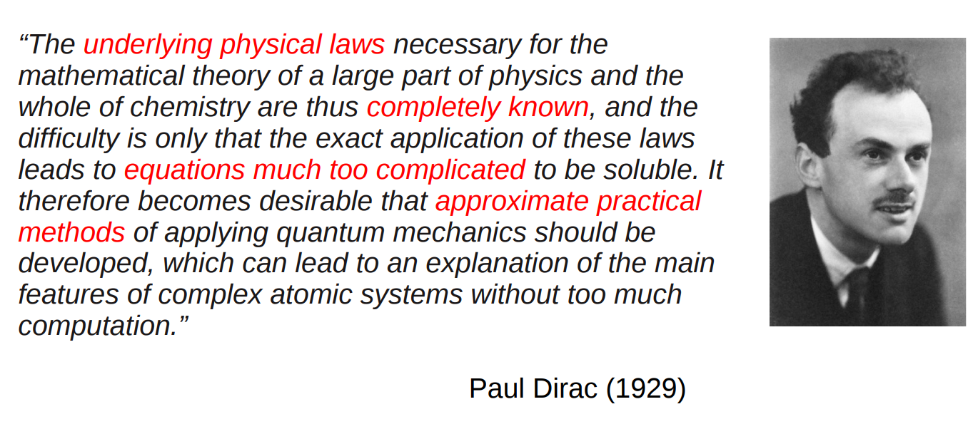
Just electrons and nuclei

Slide 17
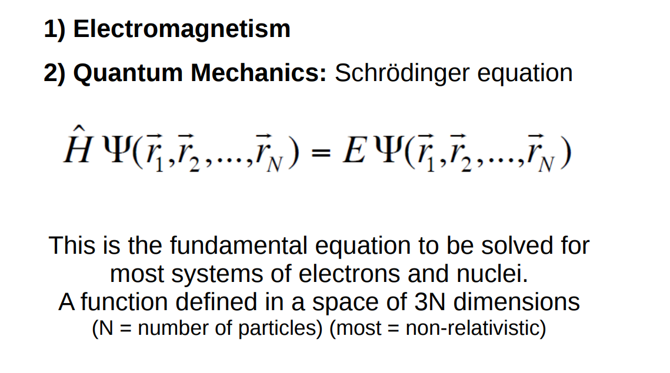
Underlying physical laws

Slide 18
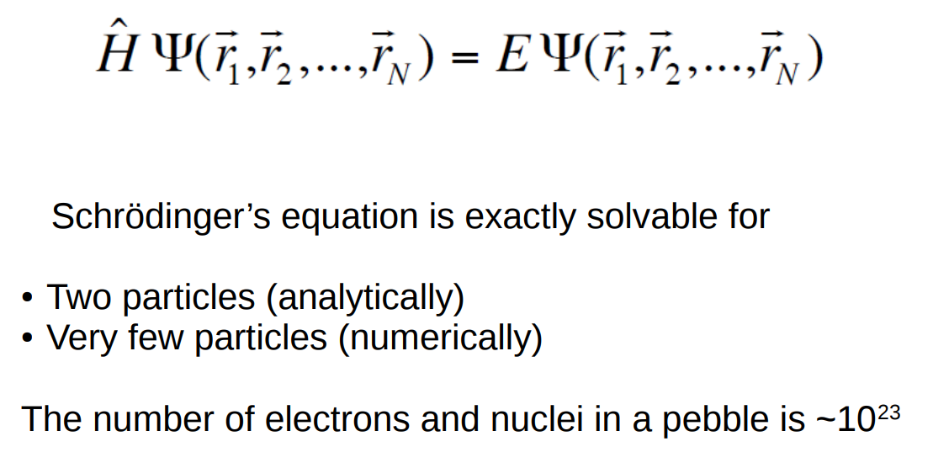
Quantum mechanics for many particles

Slide 19
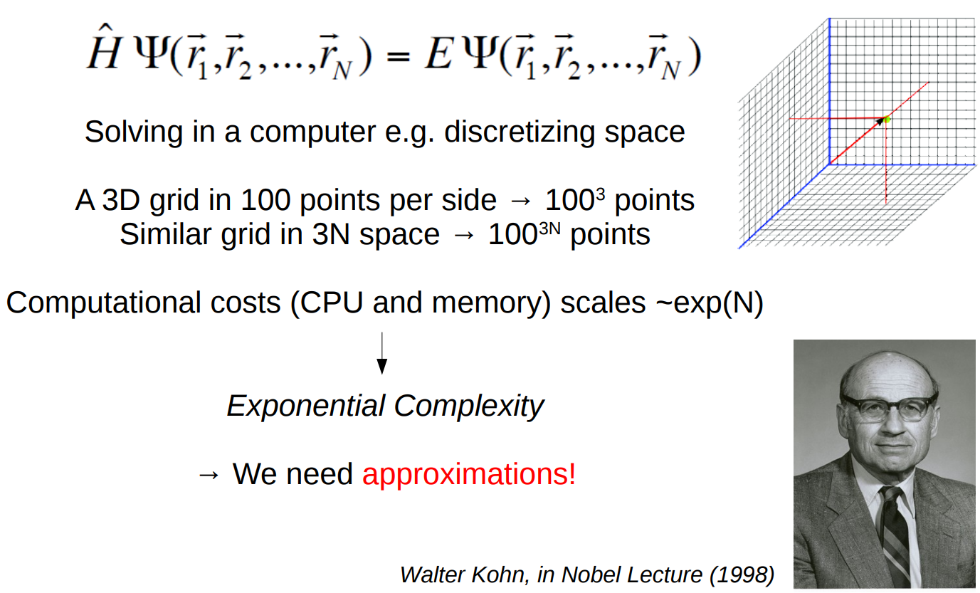
Quantum mechanics for many particles

Slide 20
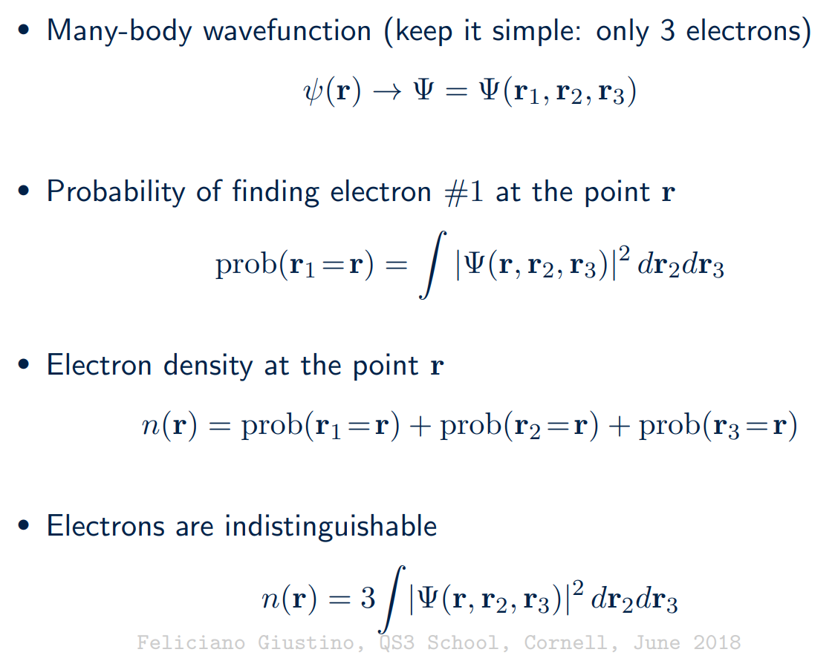
Many-body Schrodinger equation
Part – 1/5
Page – 1/40

Slide 21
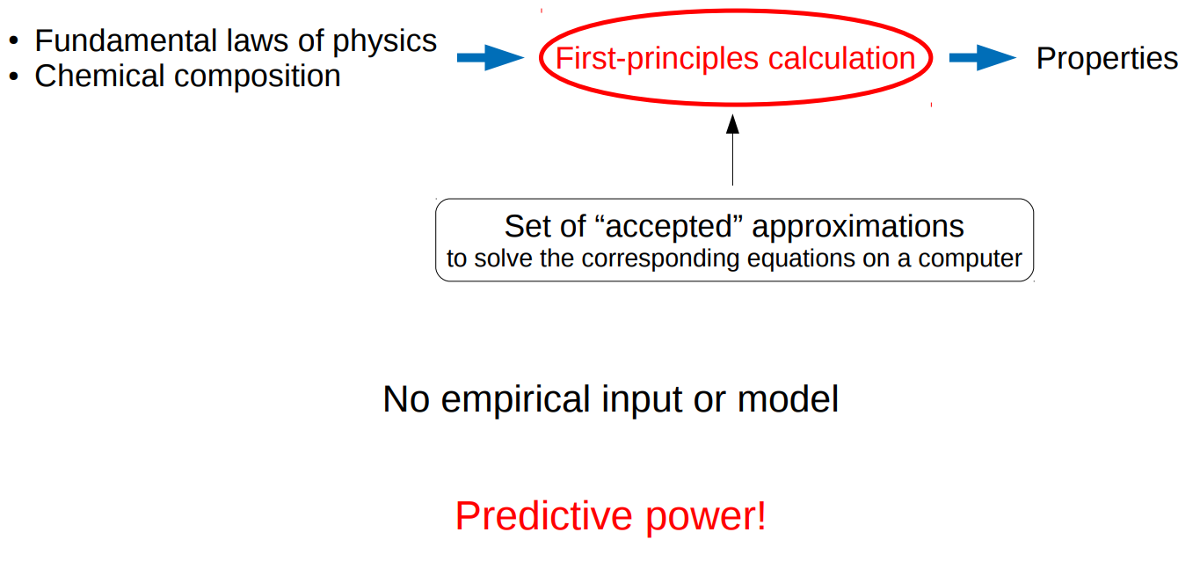
First-principles calculations

Slide 22
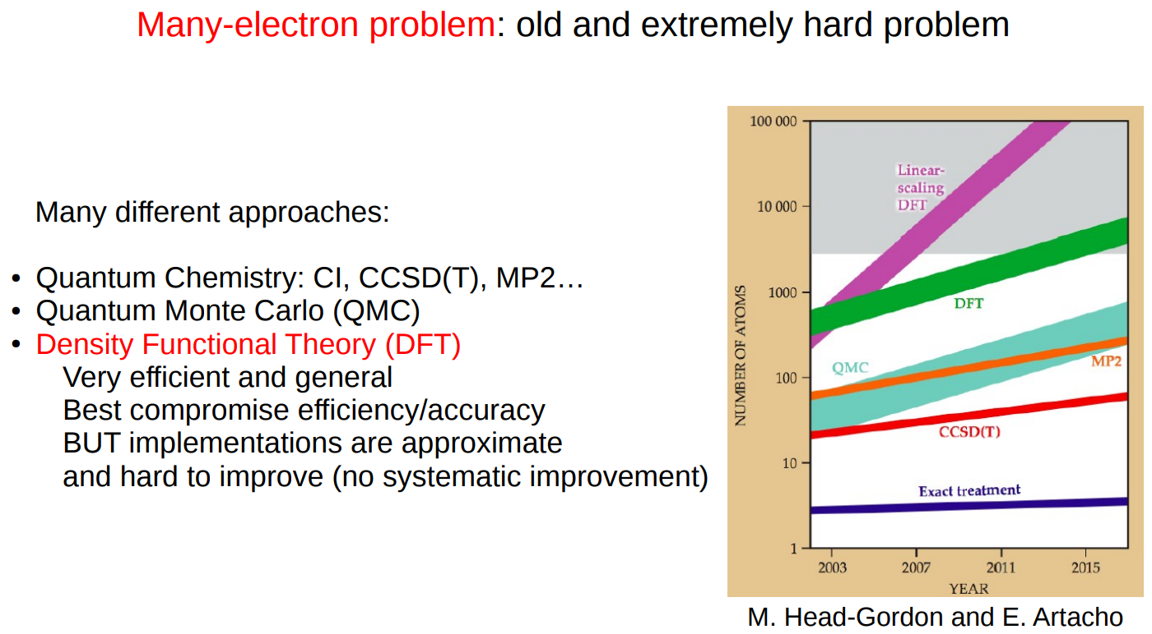
First-principles calculations

Slide 23
Total Energy Calculation:
First-principles method

Slide 24
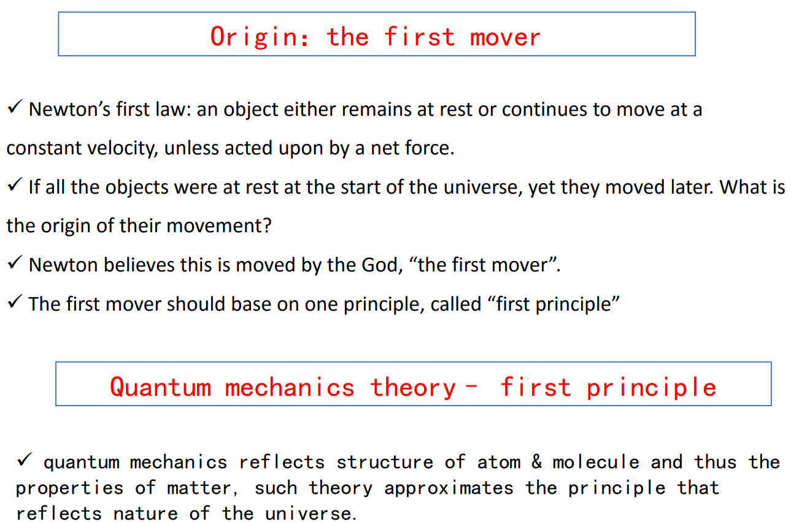
First-principles
Part – 1/5
Page – 1/40

Slide 25
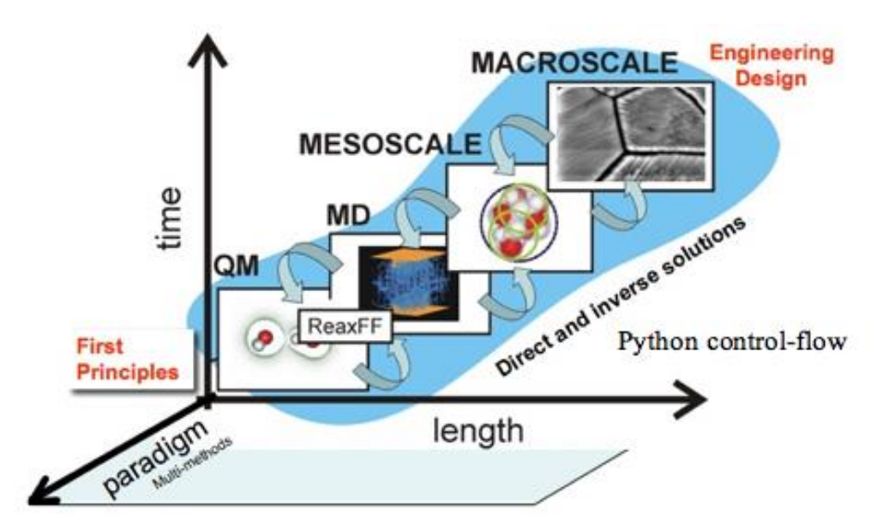
First-principles method
Part – 1/5
Page – 1/40

Slide 26
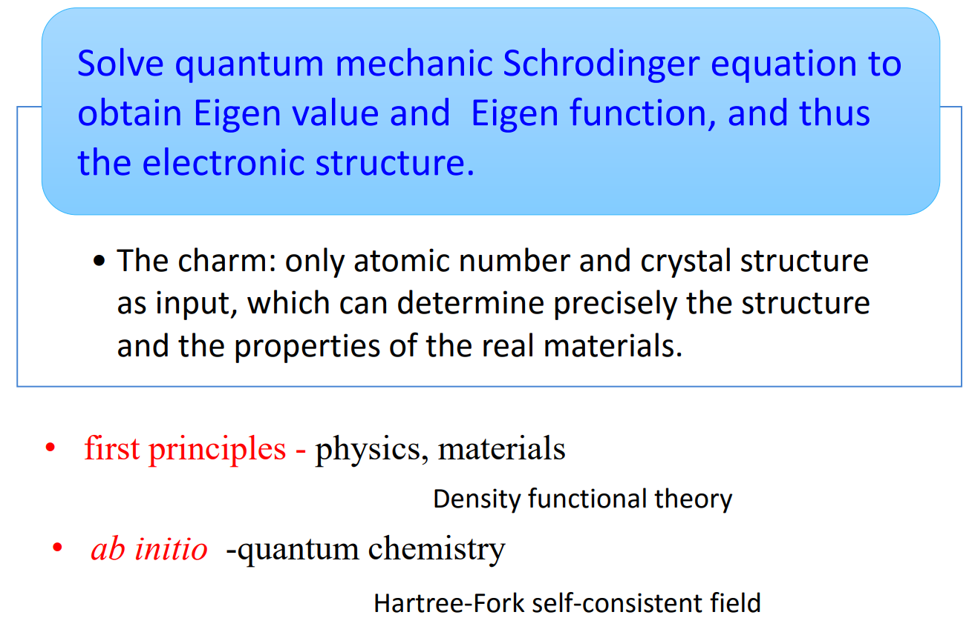
First-principles method
Part – 1/5
Page – 1/40

Slide 27
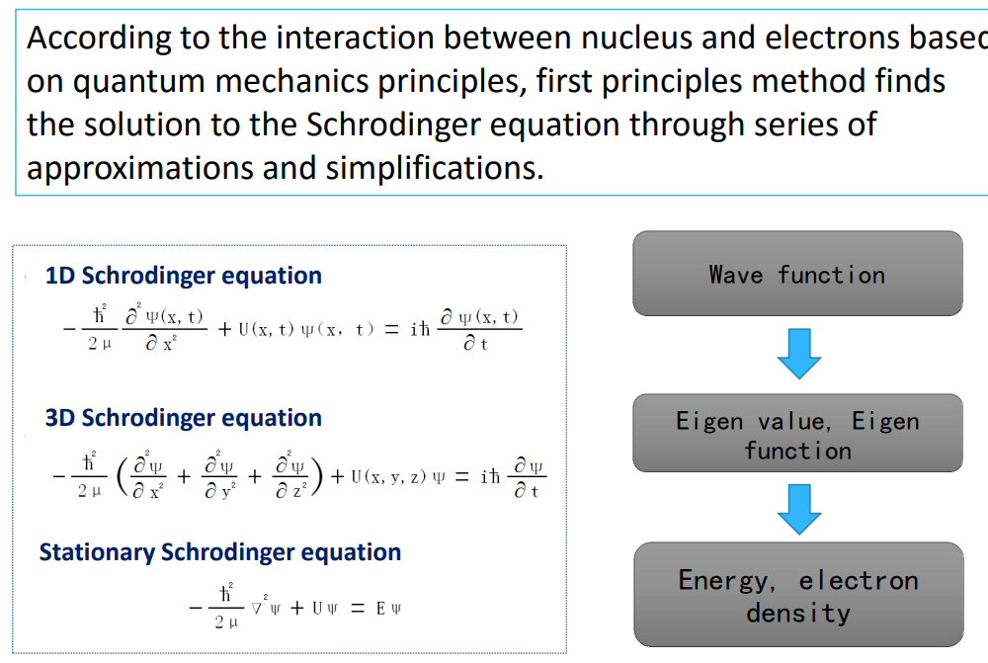
First-principles
Part – 1/5
Page – 1/40

Slide 28
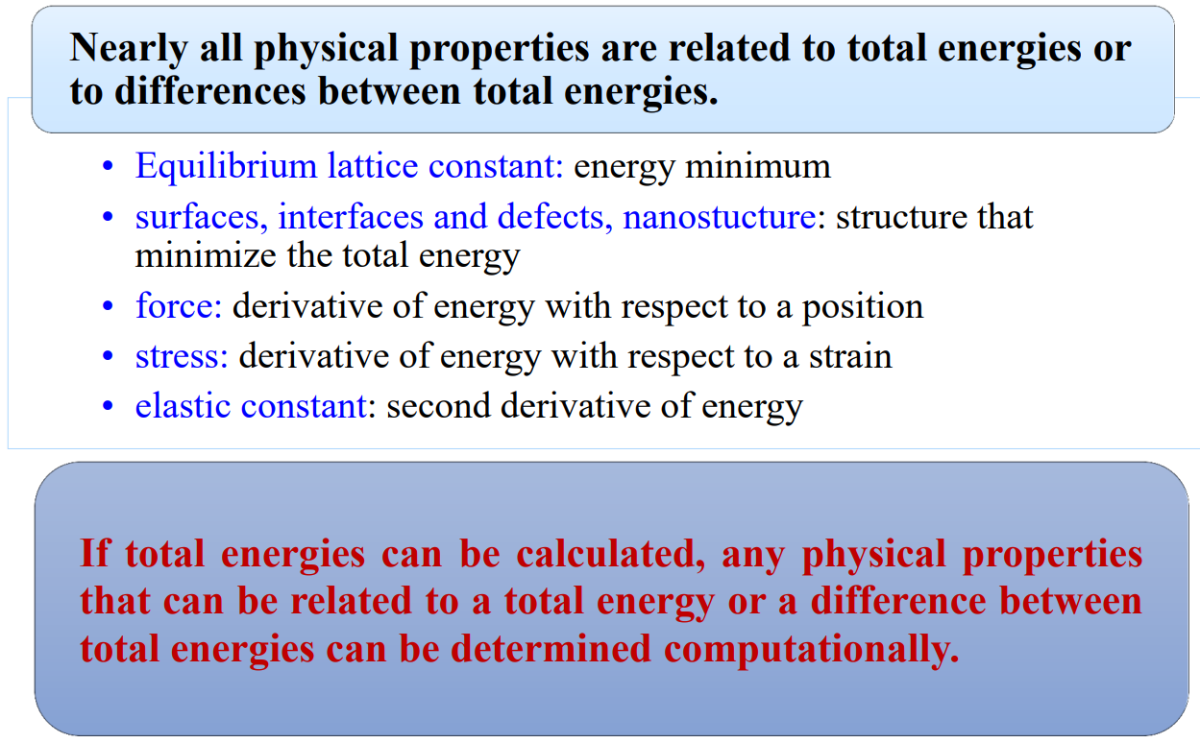
First-principles method: Total Energy
Part – 1/5
Page – 1/40

Slide 29
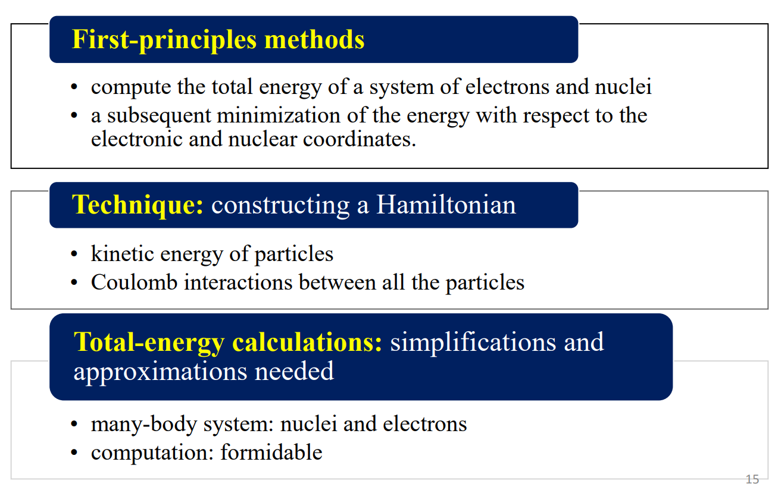
First-principles method: Total Energy Calculations
Part – 1/5
Page – 1/40

Slide 30
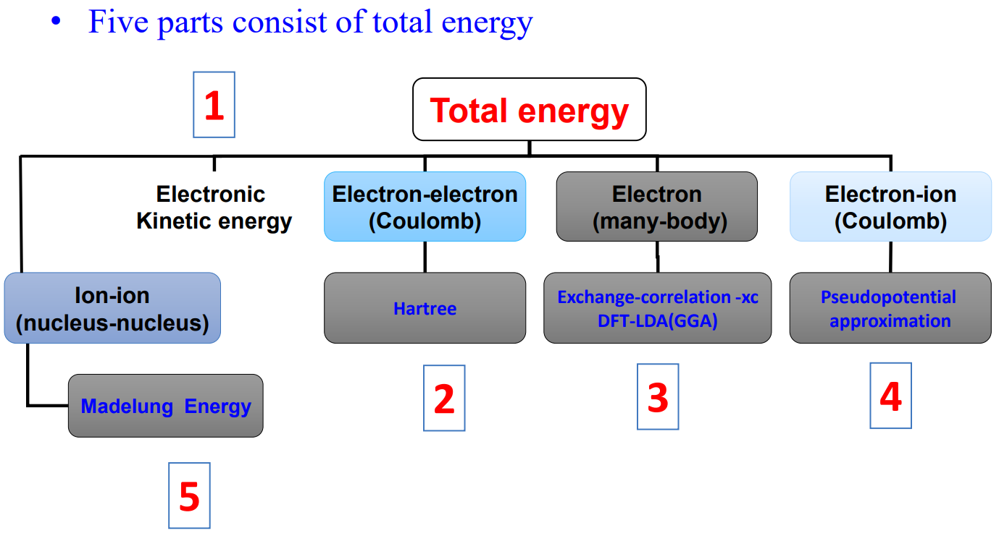
Energy calculation in a difficult interacting many-body system
Part – 1/5
Page – 1/40

Slide 31
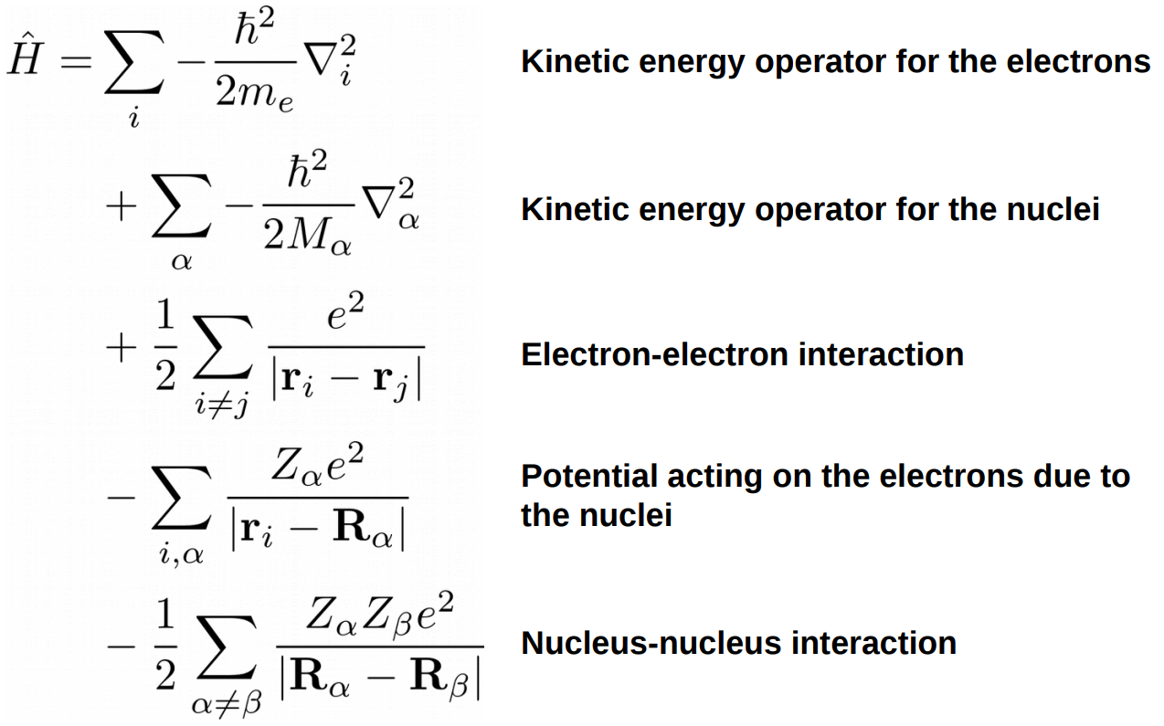
Energy calculation in a difficult interacting many-body system
Part – 1/5
Page – 1/40

Slide 32
First-principles calculations: approximations

Slide 33
Separation of electron and nucleus:
Born-Oppenheimer approximation

Slide 34
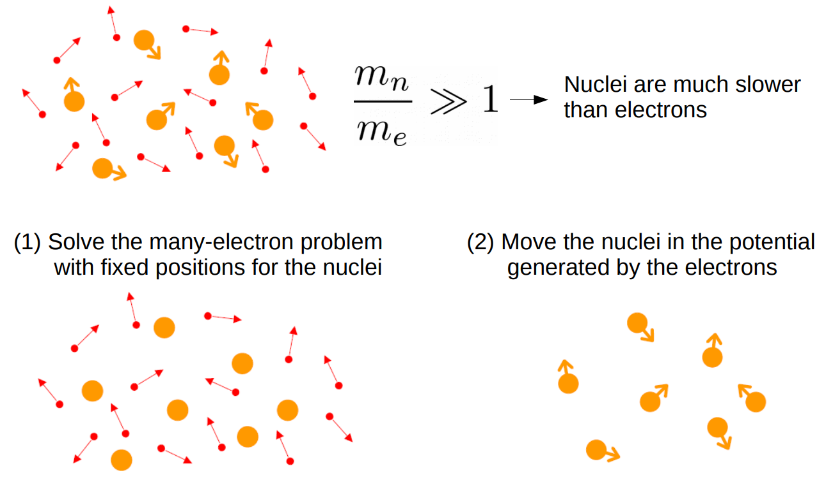
Adiabatic or Born-Oppenheimer approximation

Slide 35
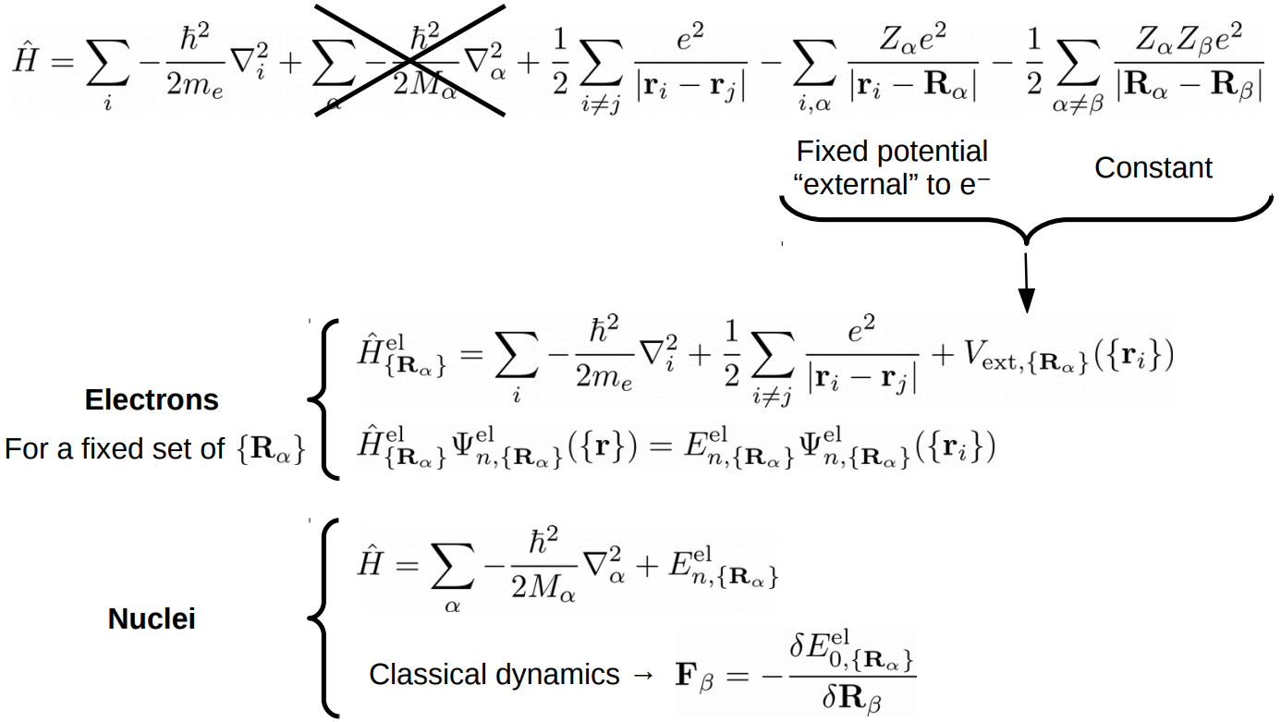
Adiabatic or Born-Oppenheimer approximation

Slide 36
2. Electron-electron interaction:
Density Functional Theorem

Slide 37
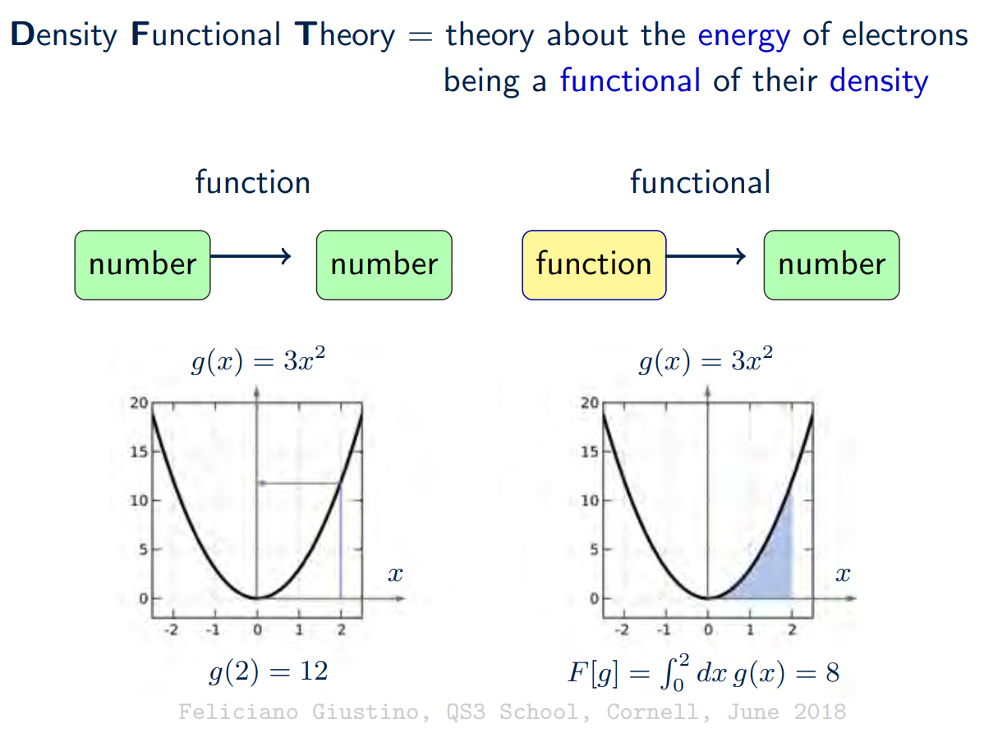
Density functional theory

Slide 38
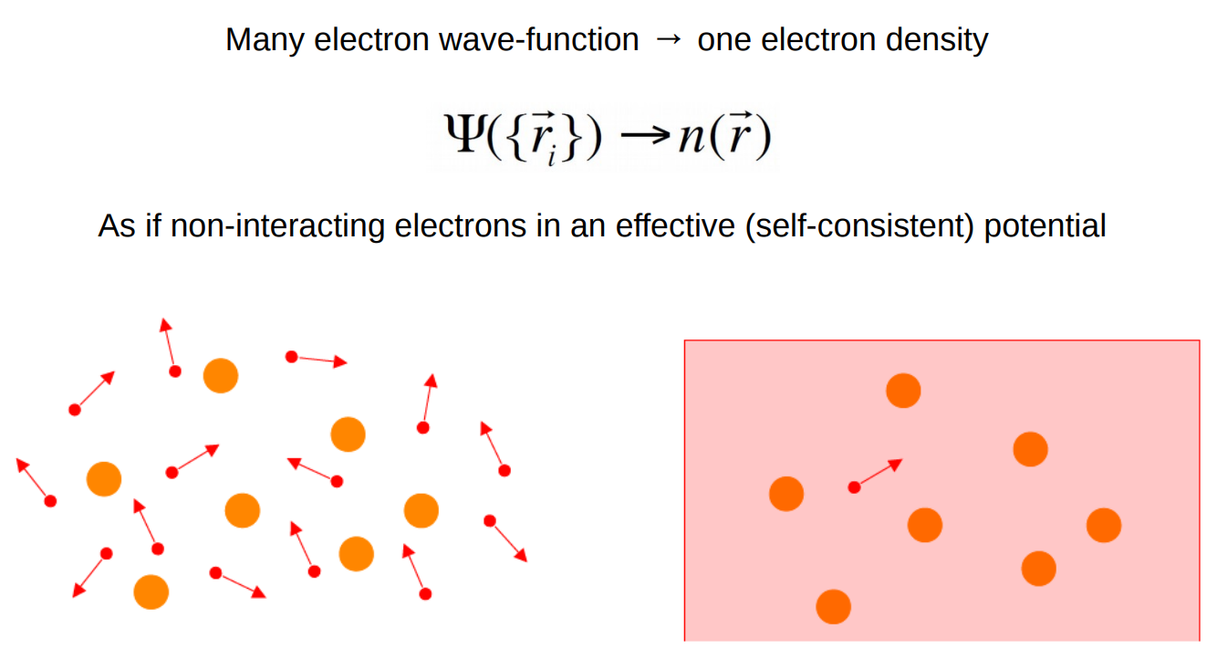
Density functional theory

Slide 39
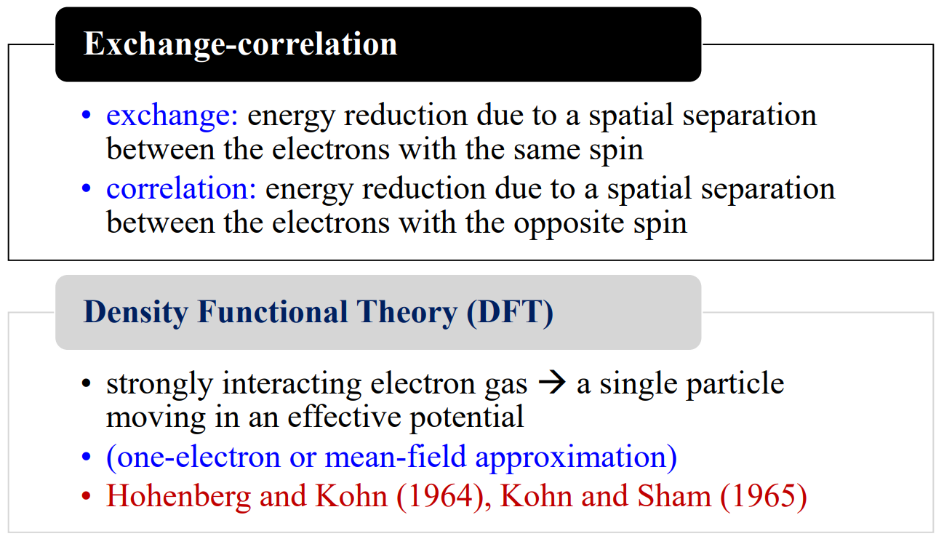
Density functional theory

Slide 40
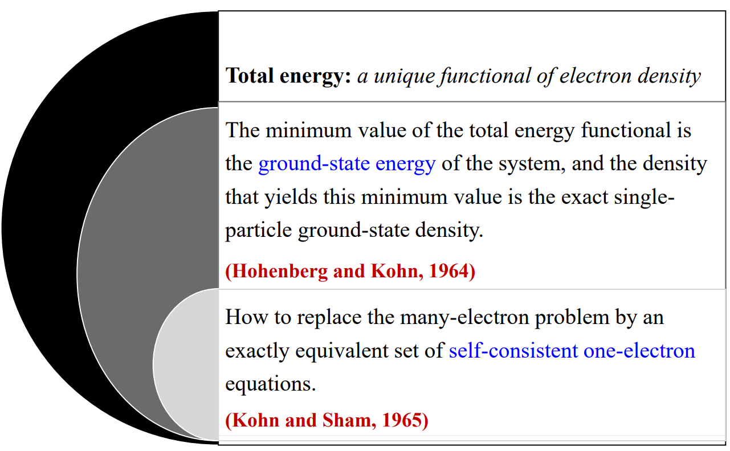
Density functional theory

Slide 41
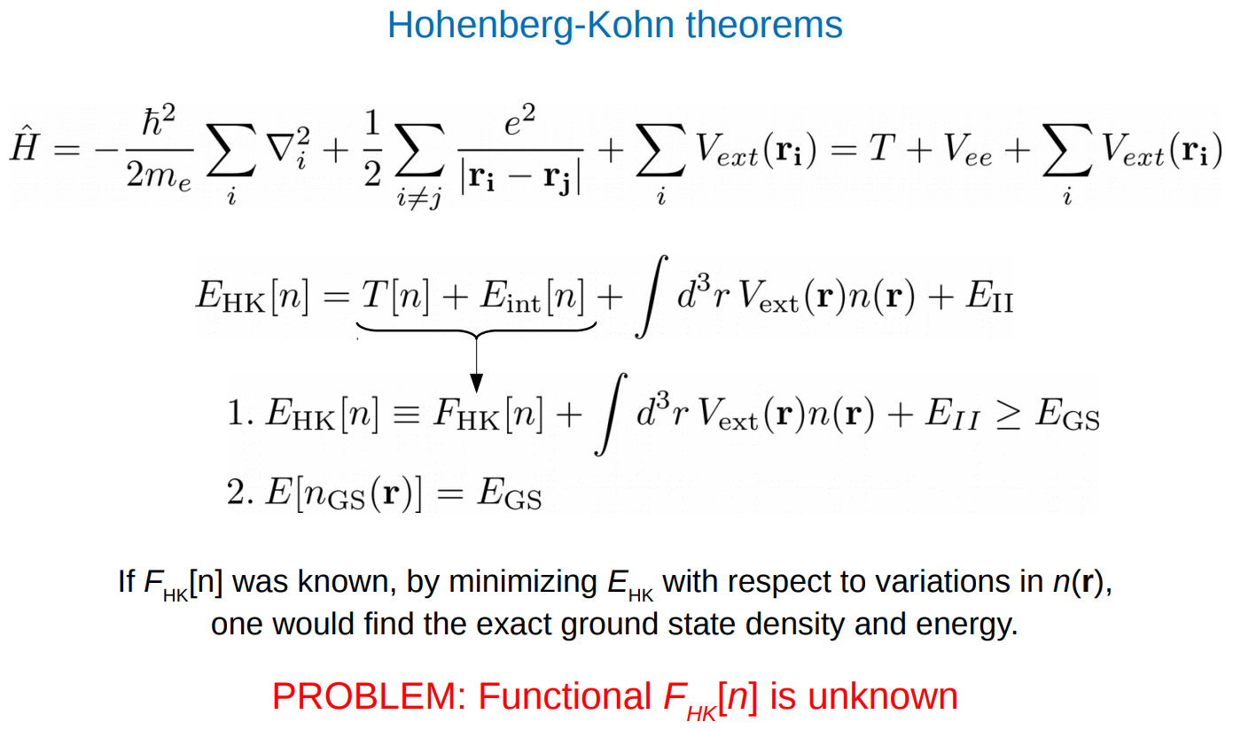
Density functional theory

Slide 42
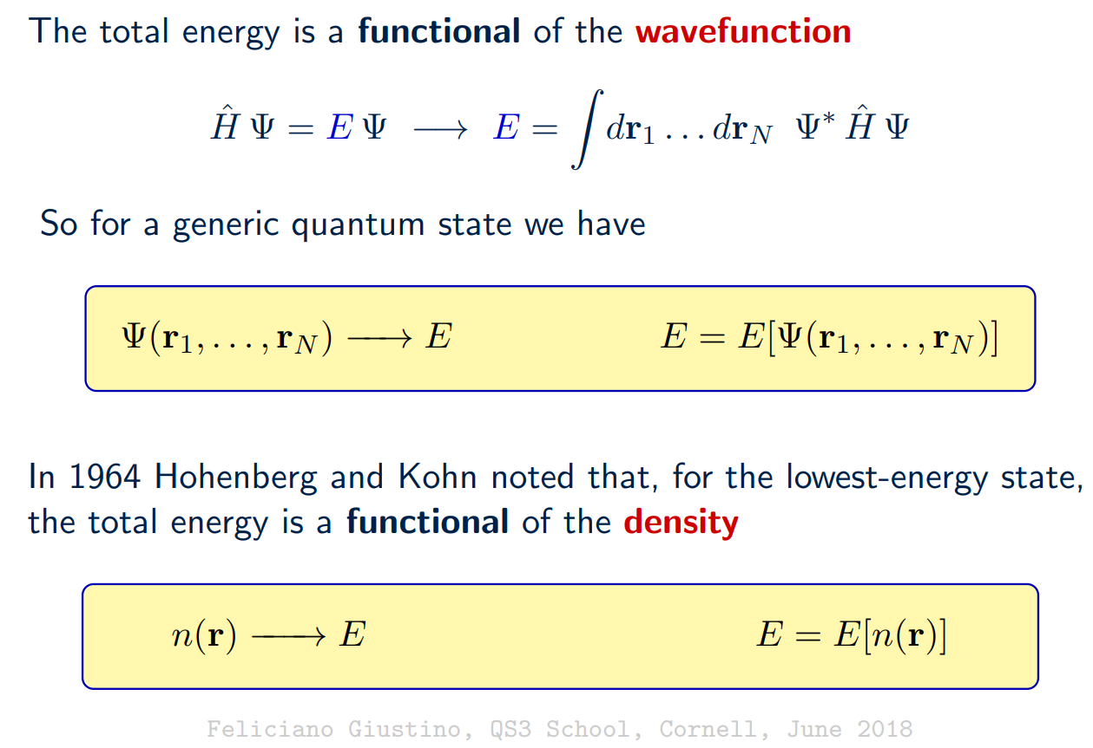
Density functional theory

Slide 43
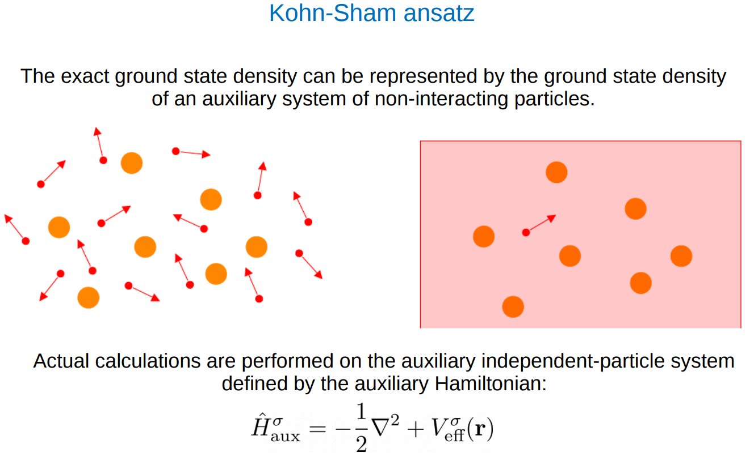
Density functional theory

Slide 44
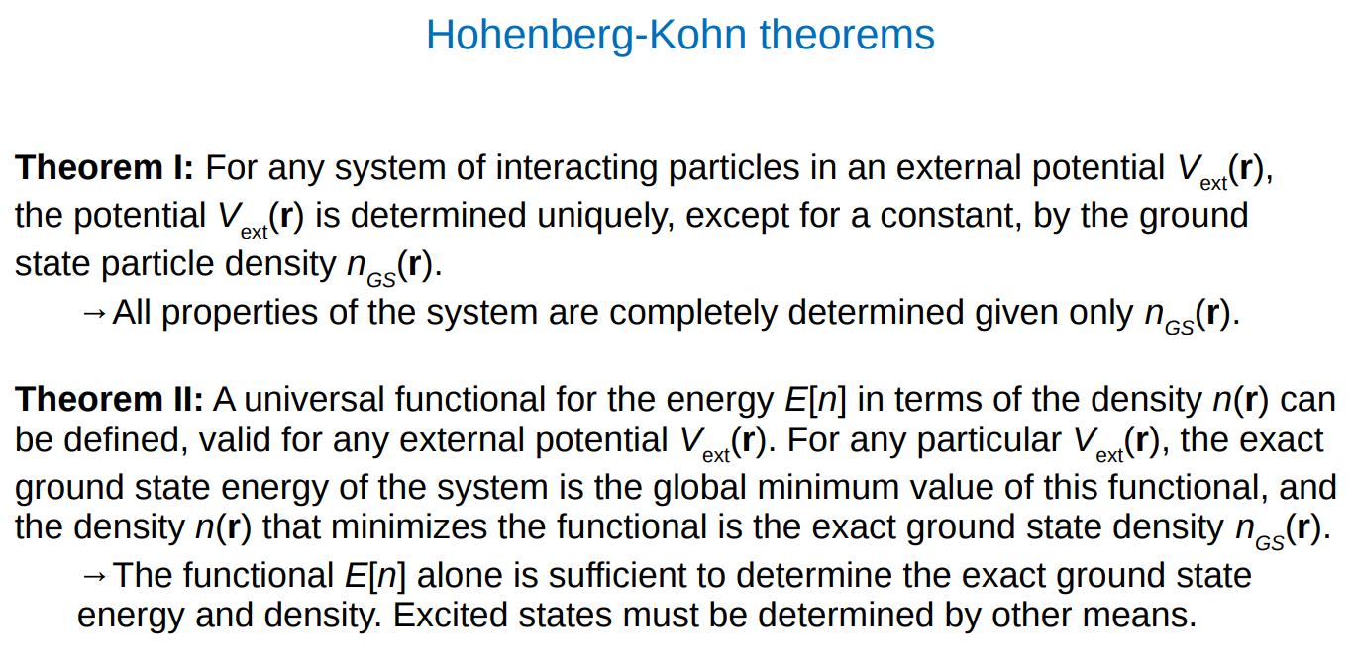
Density functional theory

Slide 45
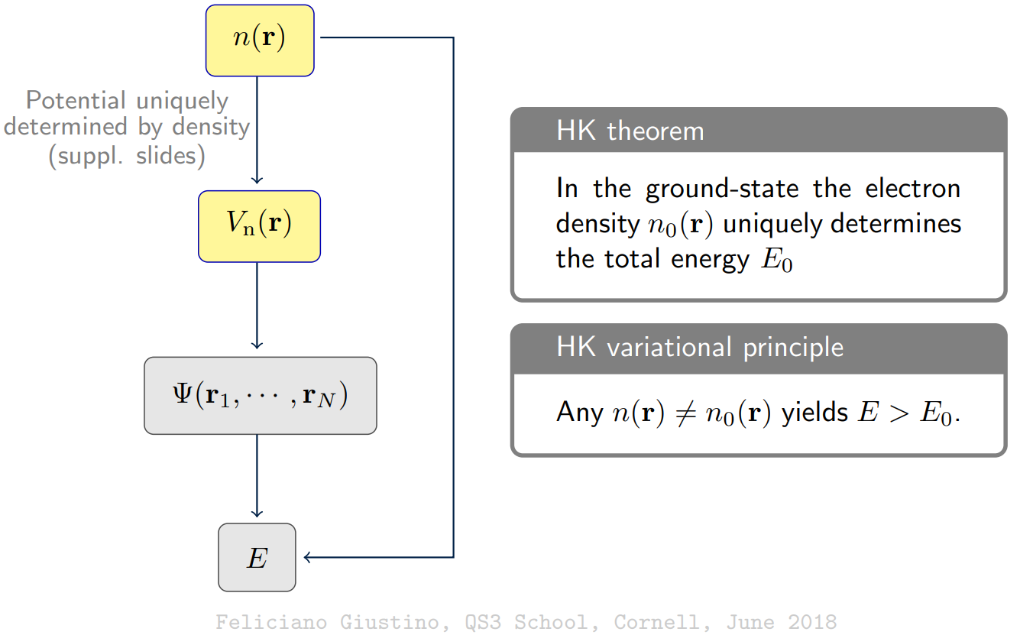
Density functional theory

Slide 46
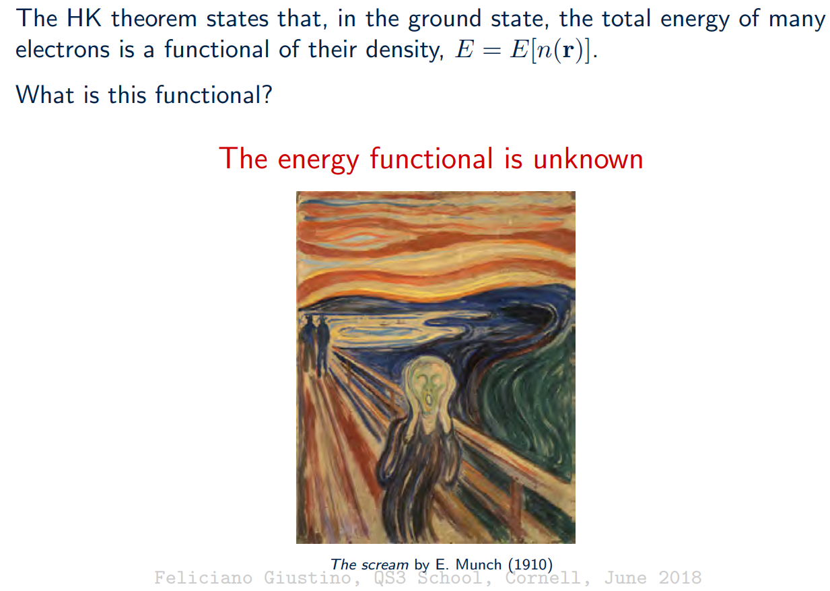
Density functional theory

Slide 47
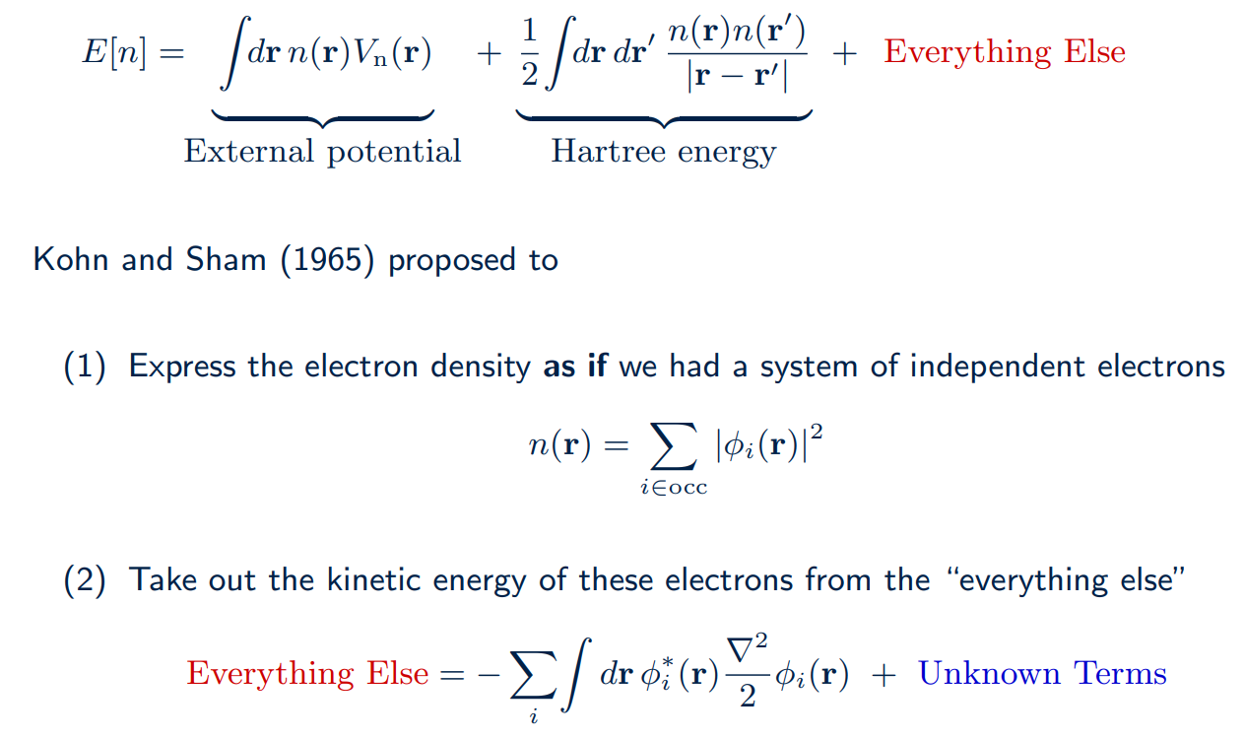
Density functional theory

Slide 48
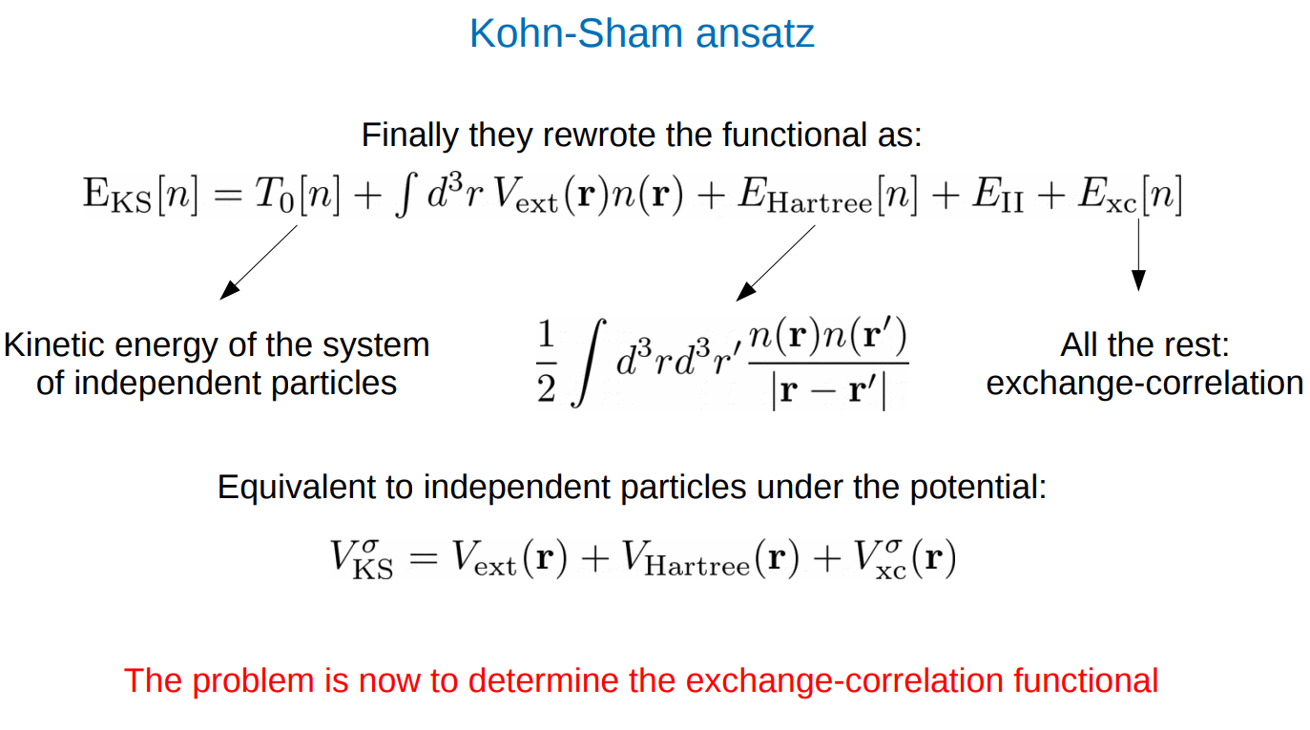
Density functional theory

Slide 49
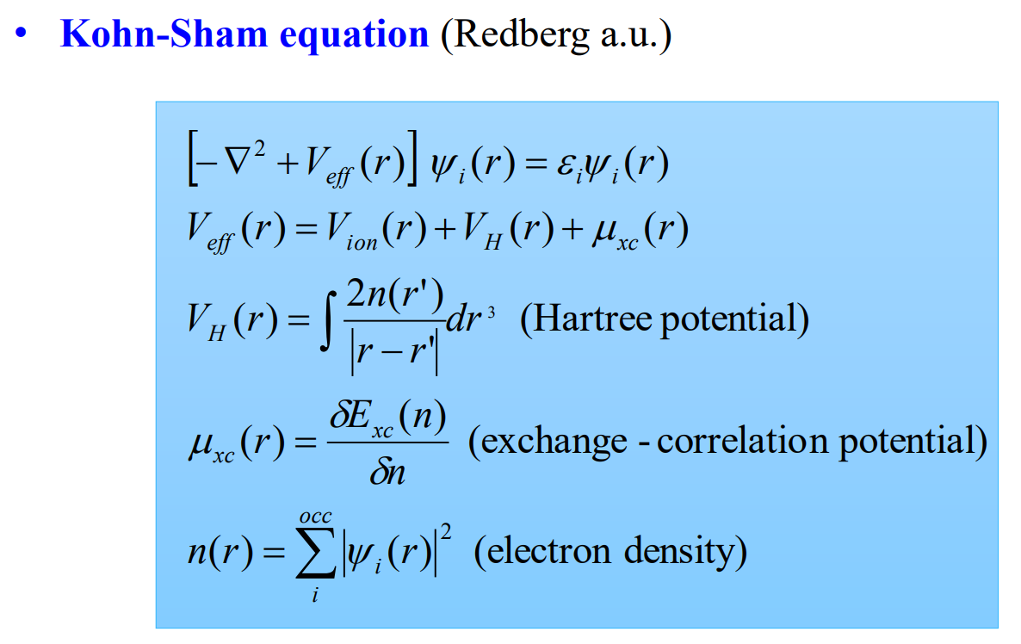
Density functional theory

Slide 50
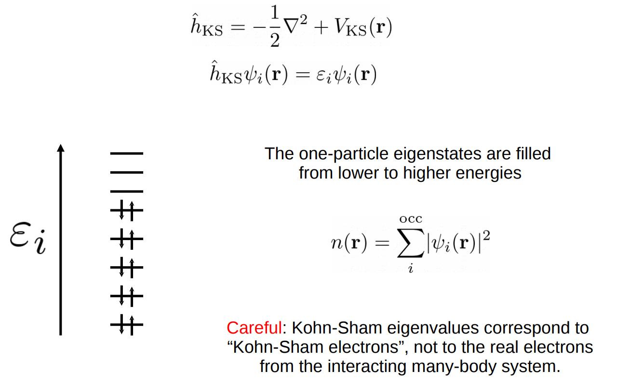
Density functional theory

Slide 51
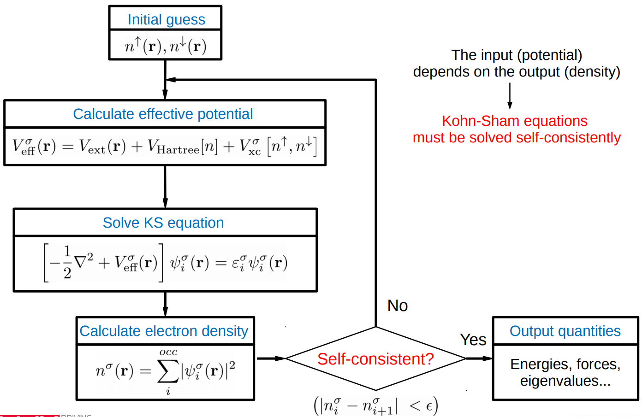
Density functional theory

Slide 52
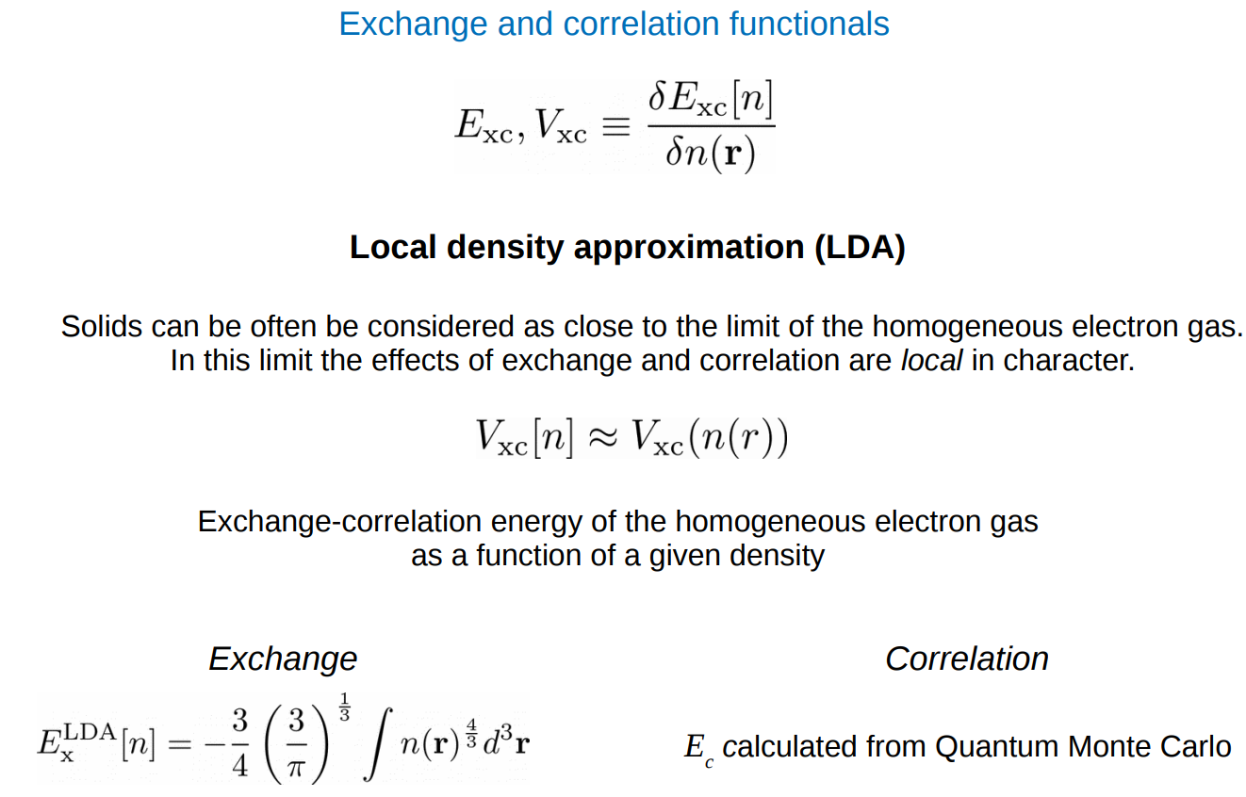
Density functional theory

Slide 53
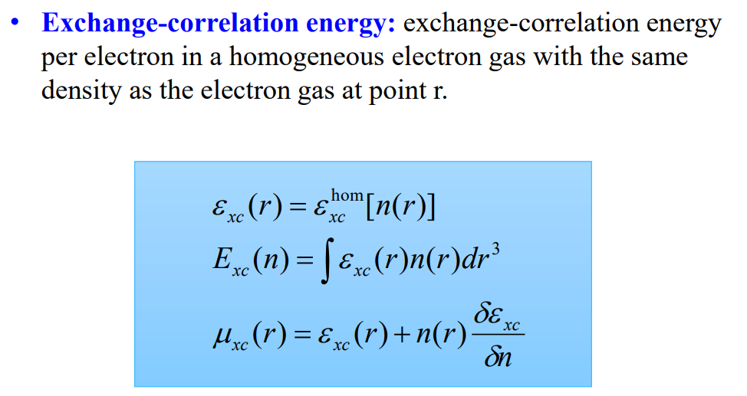
Density functional theory

Slide 54
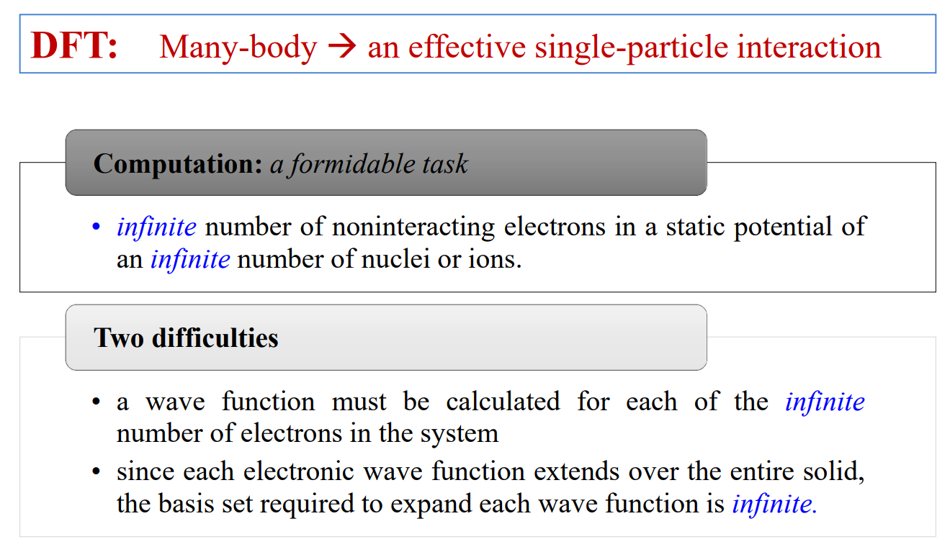
Difficulties after DFT

Slide 55
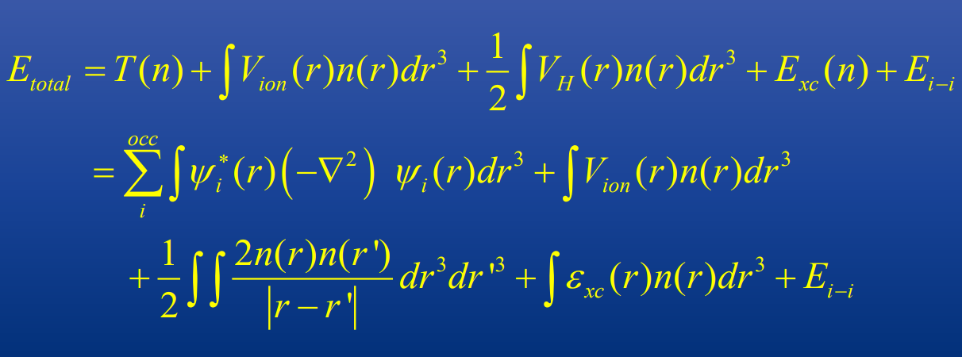
Total energy formulations

Slide 56
Bloch’s theorem – periodic system

Slide 57
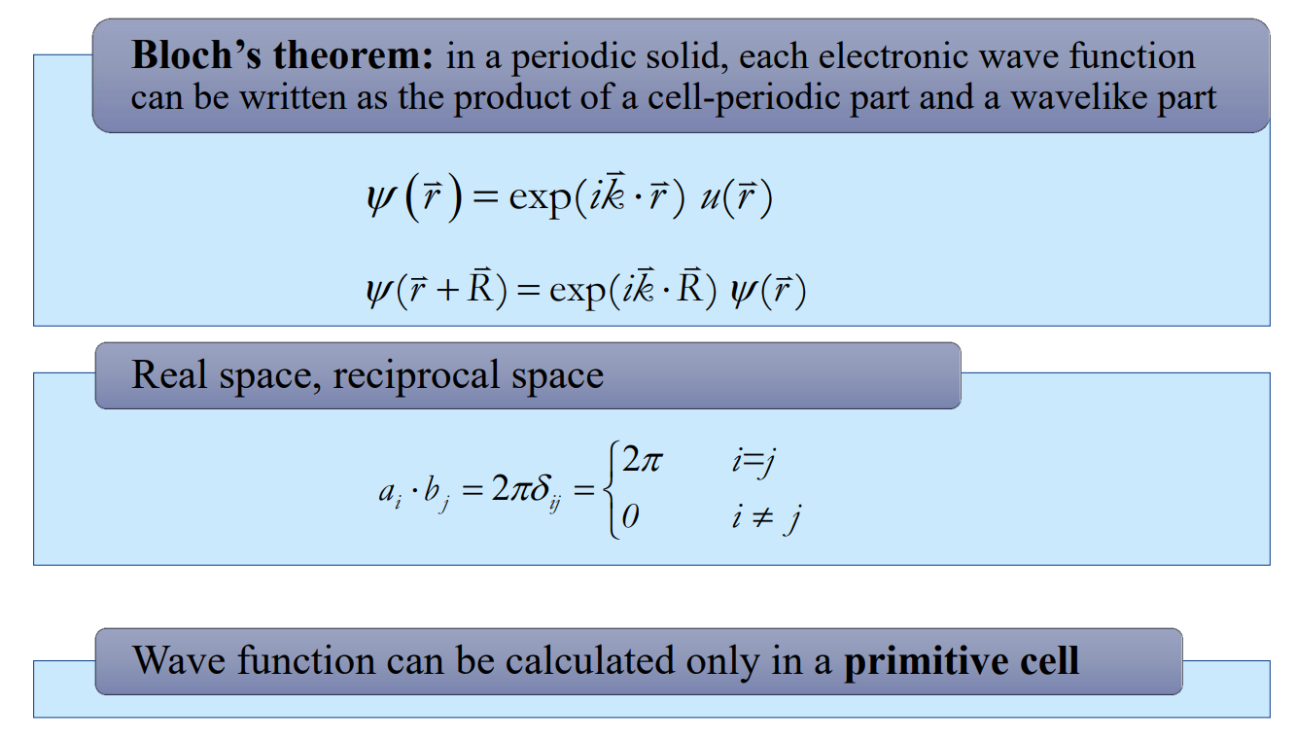
Bloch’s theorem

Slide 58
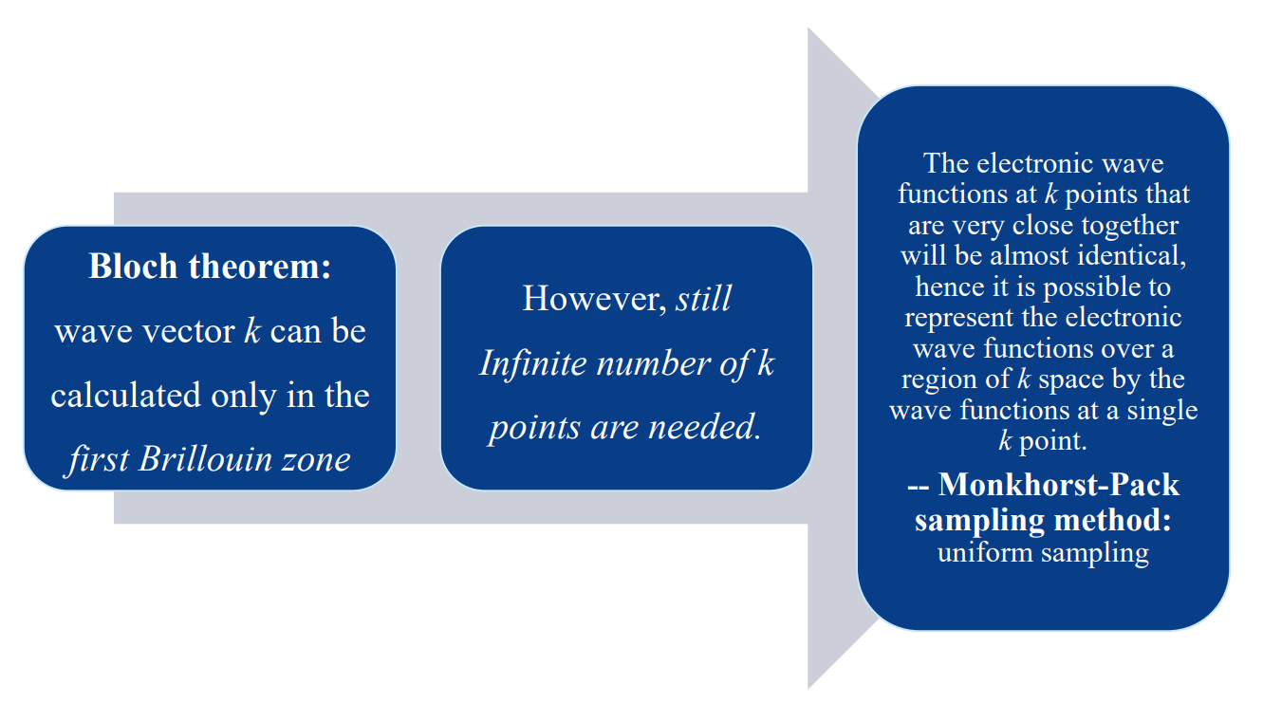
k points sampling

Slide 59
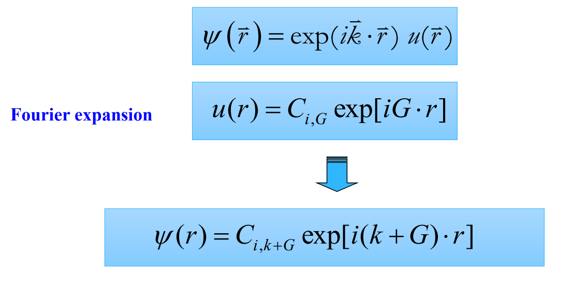
Plane wave basis set

Slide 60

Kinetic energy cutoff

Slide 61

Plane-wave representation of KS equation

Slide 62

Now system computationally tractable?

Slide 63
Electron-ion interaction (pseudopotential)

Slide 64

Separation of valence and core electrons

Slide 65

Pseudopotential approximation

Slide 66

Norm-conserved pseudopotential

Slide 67

Ultrasoft pseudopotential

Slide 68

Construct a pseudopotential (isolated atom)

Slide 69

Advantages of Pseudopotential Method

Slide 70

Nonperiodic systems: supercell approximation

Slide 71

Now computation tractable?

Slide 72

Computational procedure of FP-PP method

Slide 73
DFT
Practical considerations

Slide 74

Exchange and correlation functionals

Slide 75

Different basis sets

Slide 76

Different basis sets

Slide 77

Pseudopotentials

Slide 78

Boundary conditions

Slide 79
References

Slide 80


Major software for first-principles calculations

Slide 81



Major software for DFT: Researchers

Slide 82

Reference Books

Slide 83

Slide Credits
Introduction to First-Principles Method - Guang-Hong LU, Beihang University
[Joint ICTP/CAS/IAEA School & Workshop on Plasma-Materials Interaction in Fusion Devices, July 18-22, 2016, Hefei]

Slide 84

Slide Credits
Density Functional Theory and General Notions about First-Principles Codes - Roberto Robles
[ICN2, Barcelona, Spain]

Slide 85

Slide Credits
Introduction to density functional theory - Feliciano Giustino, Department of Materials, University of Oxford, Department of Materials Science and Engineering, Cornell University
[NSF/DOE Quantum Science Summer School Cornell University, June 10-22, 2018]

